Slide 1
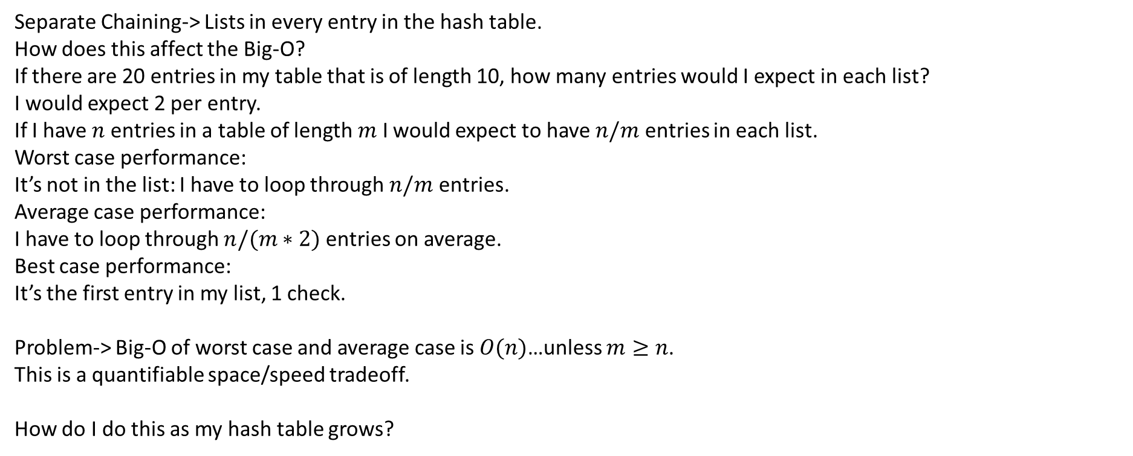
Separate Chaining-> Lists in every entry in the hash table.
How does this affect the Big-O?
If there are 20 entries in my table that is of length 10, how many entries would I expect in each list?
I would expect 2 per entry.
If I have $n$ entries in a table of length $m$ I would expect to have $n/m$ entries in each list.
Worst case performance:
It’s not in the list: I have to loop through $n/m$ entries.
Average case performance:
I have to loop through $n/(m∗2)$ entries on average.
Best case performance:
It’s the first entry in my list, 1 check.
Problem-> Big-O of worst case and average case is $O(n)$…unless $m≥n$.
This is a quantifiable space/speed tradeoff.
How do I do this as my hash table grows?

Slide 2
Science shows that prime numbers are cool
If your table length is prime, collisions are less likely.
I don’t understand the math.
If we have a prime number length and we multiply by 2…the length is no longer prime.
How do we go from a prime number to another prime number that is about double?

Slide 3
Prime Numbers | Double my prime | Double my prime+1
2 | 4 | 5
3 | 6 | 7
5 | 10 | 11
7 | 14 | 15 ☹
11 | 22 | 23
13 | 26 | 27 ☹
17 | 34 | 35 ☹

Slide 4
Depth
1:
Print me
Recurse left
Recurse right
2:
Recurse left
Print me
Recurse right
3:
Recurse left
Recurse right
Print me
0
0
1
2
1
3
4
5
6
2
3
7
8
9
10
11
12
13
14
1:
0,1,3,7,8,4,9,2,6,14
2:
7,3,8,1,9,4,0,2,6,14
3:
7,8,3,9,4,1,0,14,6,2

